Slide 1
Mind the Gaps: Short-term Crypto Price Prediction
2022 CFEM Capstone Presentation

Slide 2

Introduction:
Objectives:
Examine microstructure of BTC-USD market
Short-term price predictions for Bitcoin (<60s)
Determine best measure of ‘Fair Price’ for Bitcoin
Results:
Examined the efficacy of Quote Imbalance, Trade Imbalance, Volume Adjusted Mid-Price (VAMP), and potential combinations of these
VAMP best captures intricacies at the top of the order book, leading to the best predictions
Notes:
Sasha’s micro-price

Slide 3
Data & Feature Engineering

Slide 4
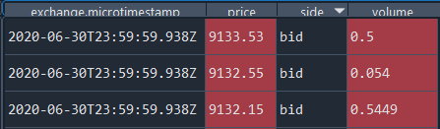
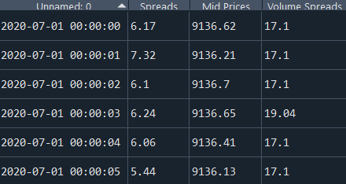
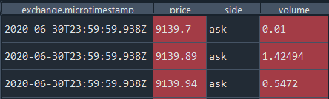
Quotes Updates:
Raw Data:
Processed:
Notes:
Start with EOD snapshot,
Processing goal - calculate all features of the LOB at every second throughout our dataset

Slide 5
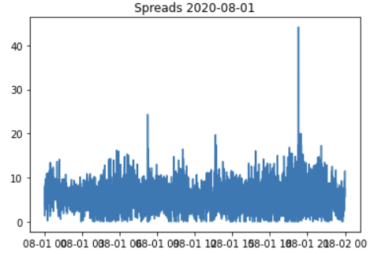
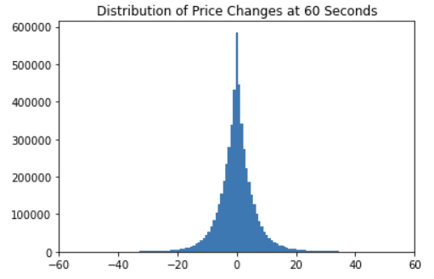
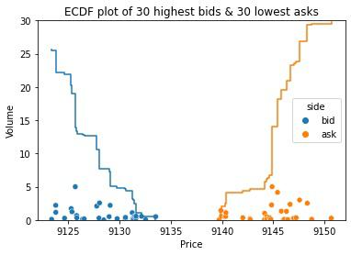
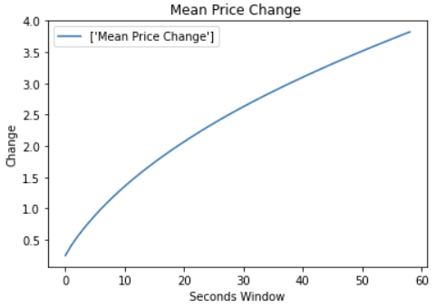
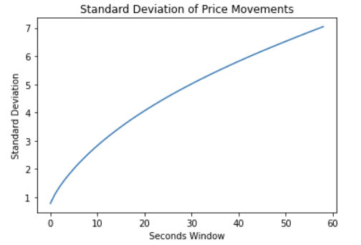
Exploratory Data Analysis
Notes:
Structure plot - emphasizes frequent and significant gaps in LOB
MPC plot/Std dev plot - very small changes/volatility at short intervals - hard to produce meaningful predictive power
Dist of change in price - tightly centered around 0, long but skinny tails

Slide 6
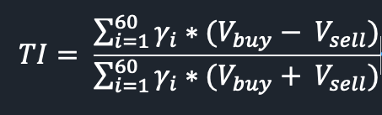
Trade Imbalance - Definition
Trade imbalance ​​is a number in [-1,1]
Trade imbalance is aggregated in the past 1-minute window, with a weight linear parameter Gamma assigned to the trade in each second. In this case, the closer the trade time to the current time, the large weight it will have in the trade imbalance calculation.

Slide 7
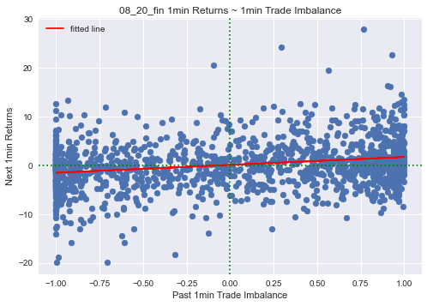
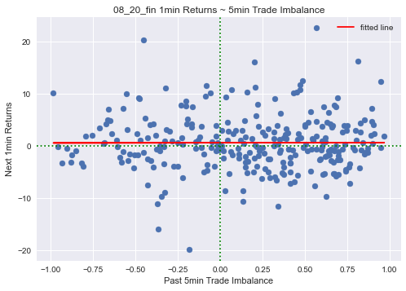
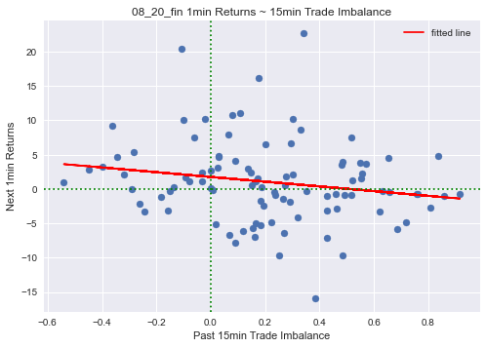
Trade Imbalance - Pre-window selection
Sample Dates: 1st, 10th, 20th in July, August and September (9 days)
Pre-window candidates: 1min, 3min, 5min, 10min, 15min, 20min, 25min, 30min
Criteria: P-value and R-squared from Linear Regression,

Slide 8
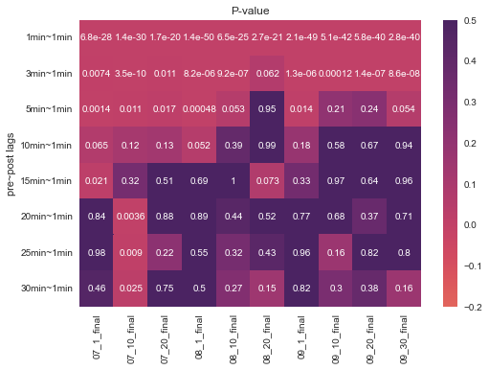
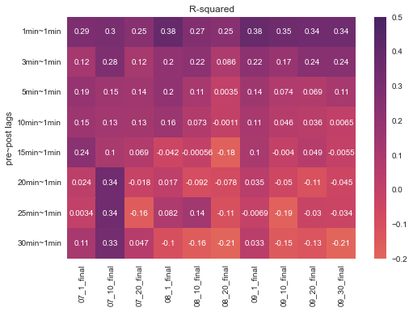
Trade Imbalance - Pre-window selection
Sample Dates: 1st, 10th, 20th in July, August and September (9 days)
Pre-window candidates: 1min, 3min, 5min, 10min, 15min, 20min, 25min, 30min
Criteria: P-value and R-squared from Linear Regression,

Slide 9
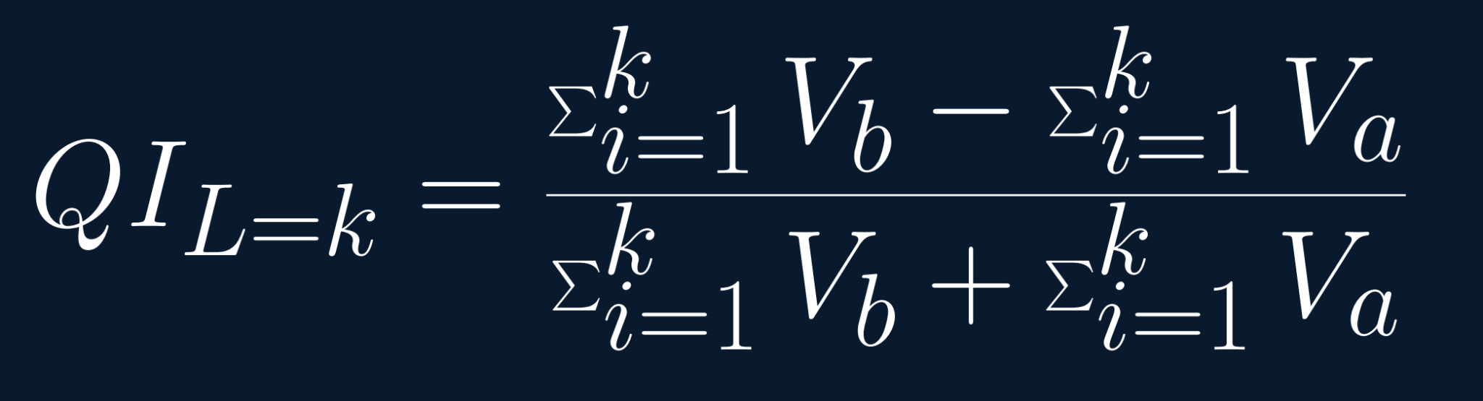

Quote Imbalance - Definition

Slide 10
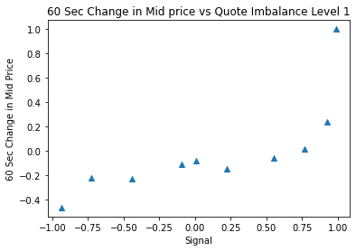
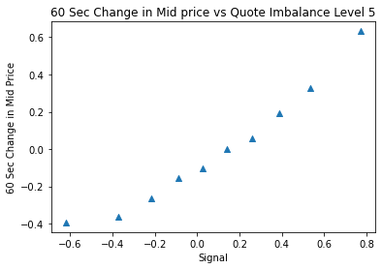
Quote Imbalance - Exploration

Slide 11
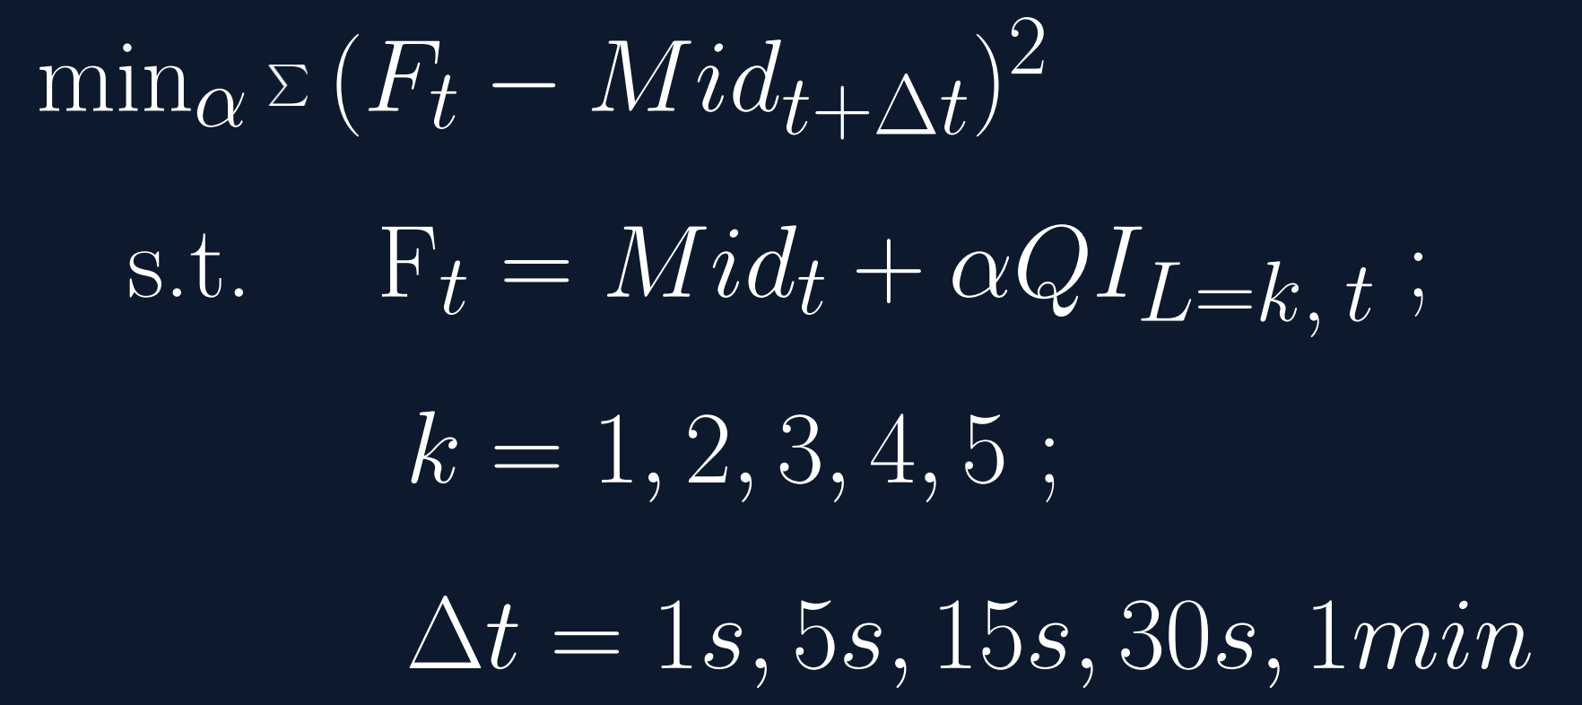
Quote Imbalance – Optimization Model
Notes:
Price levels - only considering prices where there is volume

Slide 12
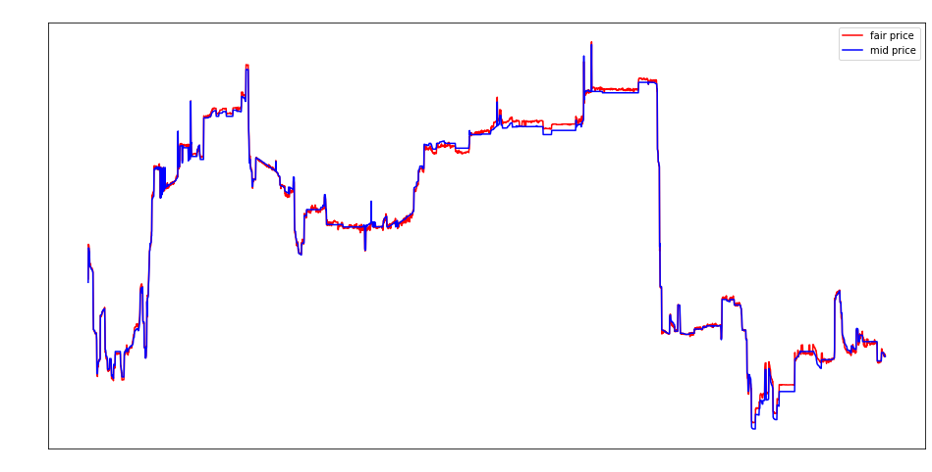
Quote Imbalance - Exploration

Slide 13
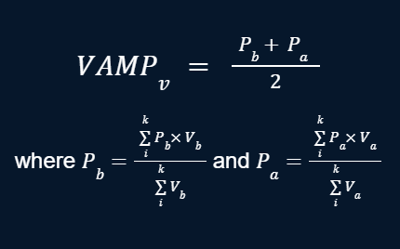
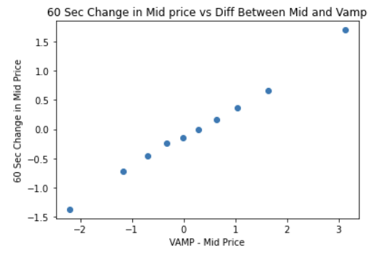
Volume Adjusted Mid-Price (VAMP)
Notes:
(Volume Weighted best ask - VWBB)/2
Other measure of ‘imbalance’ - Encompasses idea of imbalance at the top of the book (Volume Weighted Average)

Slide 14
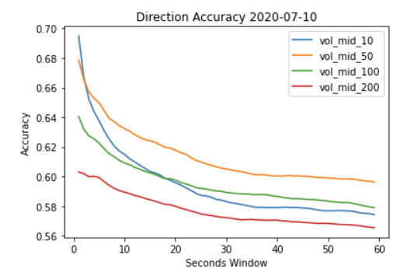
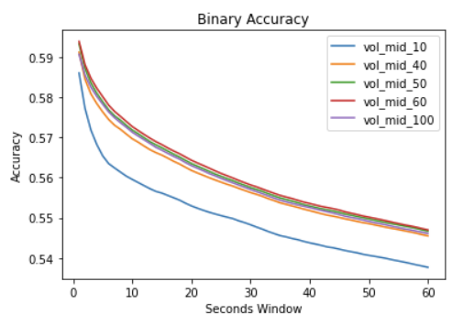
VAMP - Exploration

Slide 15
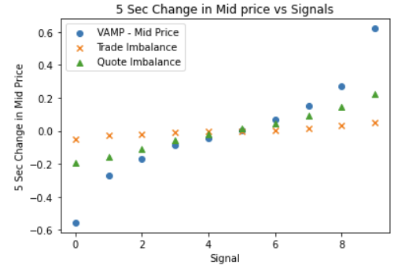
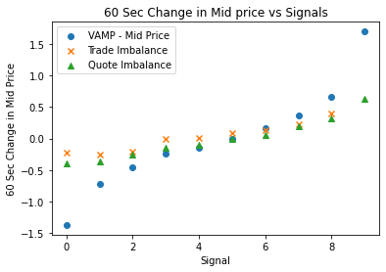
Signal Comparison
Notes:
Proportionality of changes in signals vs. changes in mid-price
VAMP looks best, but linear relationship w other signals shows that we should not give up on them just yet

Slide 16
Preliminary Metrics

Slide 17
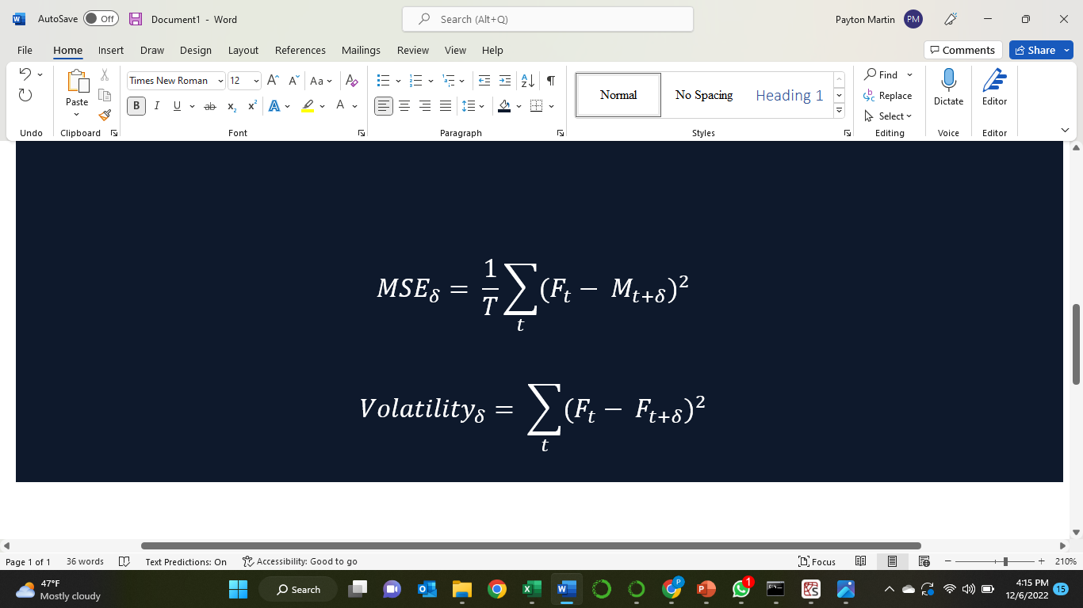
Preliminary Metrics: Volatility
Volatility: measures the fluctuation within fair price itself throughout the whole testing period.
The lower, the better: if a fair price’s definition truly reflects the intrinsic value, it should have lower volatility.

Slide 18
Preliminary Metrics: MSE
MSE: measures the overall accuracy of fair prices on predicting future mid prices.
The lower, the better.

Slide 19
Trading PnL
Position: 1(bullish), 0(neutral), -1(bearish)
Threshold = std of (fair price - mid price)
Signal = fair price[t] - mid price[t]
Return = (final price- initial price)/initial price
Position = 0
If signal > threshold>0
If signal <- threshold<0
If signal <- threshold<0
Position = 1
Position = -1
If signal > threshold>0
Notes:
While our use case is not trading itself, we believe this gives an initial idea of how good a definition is at predicting directional changes and how responsive that definition is to changes in order book
Long/out of market/short positions

Slide 20
Metrics Evaluation Results
For windows less than 30 seconds, Mid has lowest MSE and vol, showing that mid price does not change much within 30s timeframe. After 30 seconds, VAMP begins to lower MSE.
Trading PnL is dominated by VAMP; Quote imbalance was slightly better than Trade imbalance.
 | VAMP | Quote Imbalance | Trade Imbalance
Trading PnL | 1.2543 | 1.0152274 | 0.9939
Notes:
(early indication that VAMP may predict direction better than the other definitions)
Possibly include pnl’s
Maybe statistic of how after 30 seconds VAMP has better MSE but only slightly, indicating that Mid price does not move very much on average even at the 60 second range

Slide 21
Classification Results

Slide 22
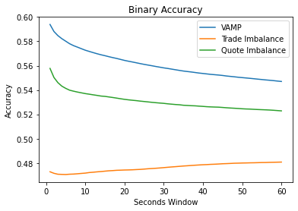
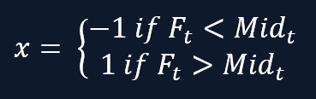
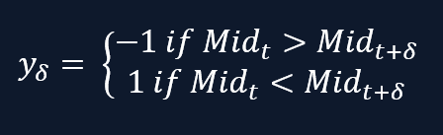
Binary Classification - Accuracy
Objective: How well does each definition predict direction of price movement?

Slide 23
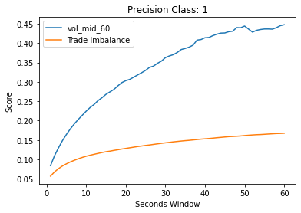
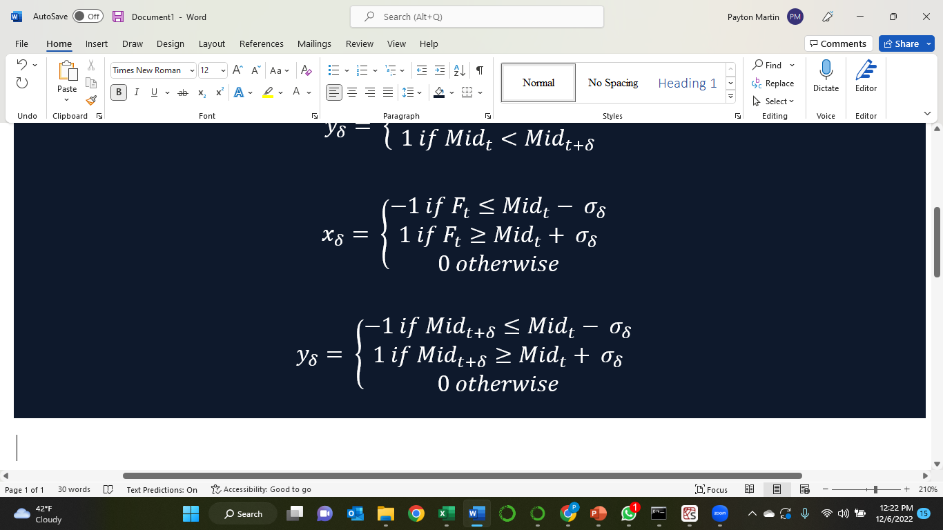
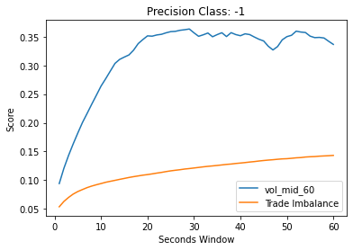
Multiclass Classification - Precision
Objective: When the fair price predicts large price movements, how often is it right?

Slide 24
Conclusions
VAMP seeked to improve upon a quote imbalance adjusted mid-price by capturing more information such as large gaps in the LOB
Early signs pointed to strong signal between VAMP and future price movements
Quote and Trade imbalance underperformed VAMP in nearly all classification metrics
VAMP used as a 60-second future price direction signal is robust across across the various market microstructure conditions seen from July-September 2020

Slide 25
Future Work
More data!
More BTC Data
More assets to test VAMP
Thank you Sasha and Covario!

